Slide 1
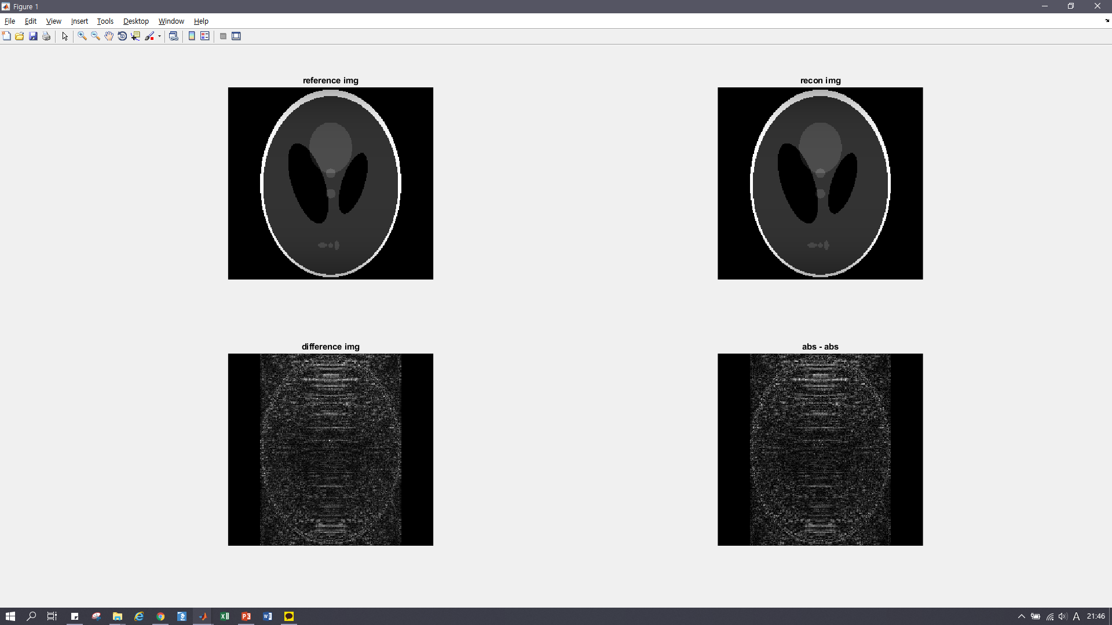
Ky = 그대도
Y = 그대로

Slide 2

Ky = -1씩 shift
Y = 그대로

Slide 3
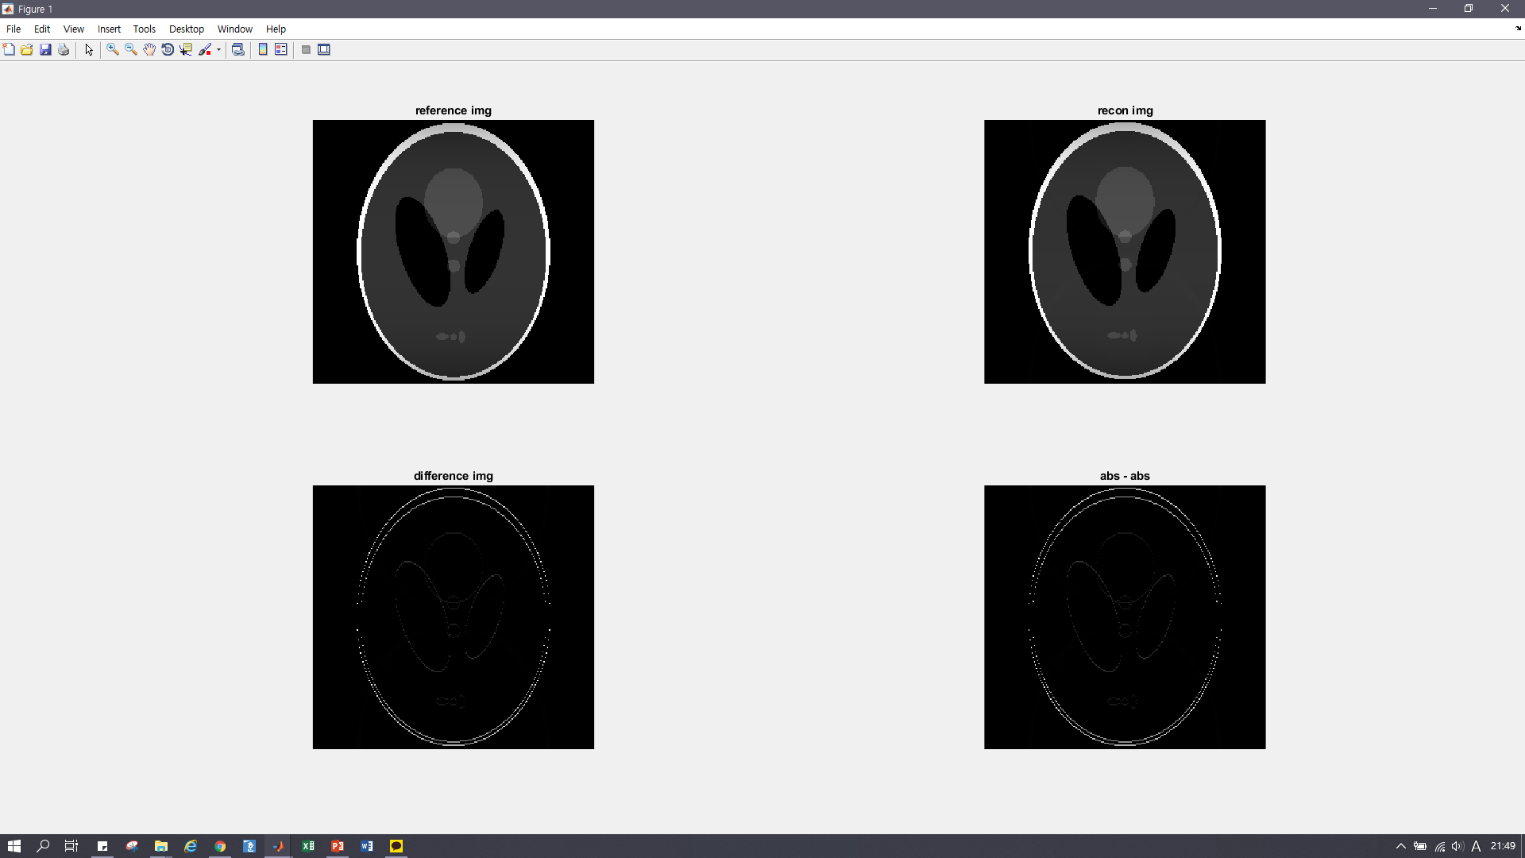
Ky = 그대로
Y = -1씩 shift
Shifted diff img’s max = 0.0140 + 0.0000i
Unshifted diff img’s max = -1.3878e-16 + 4.3601e-18i
이거는 diff img reliabilit가 좀 떨어지는듯…. r_fac = 4에서 recon img에 aliasing 나오는데 difference img still shows clear difference img
Shifted along y direction → probably the whole recon img is shifted → only rapidly changing parts are shown
: comparing max

Slide 4
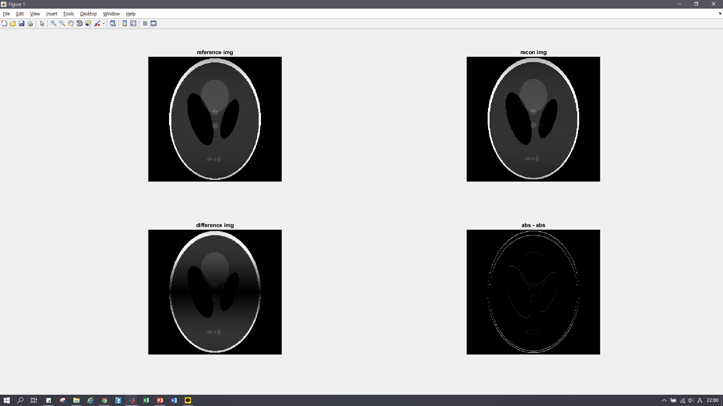
Ky = -1씩
Y = -1씩
Shifted in k-space => phase modulation → difference img difference
Shifted in img domain => the whole img’s index is shifted → only rapid changing parts are shown on abs-abs img

Slide 5
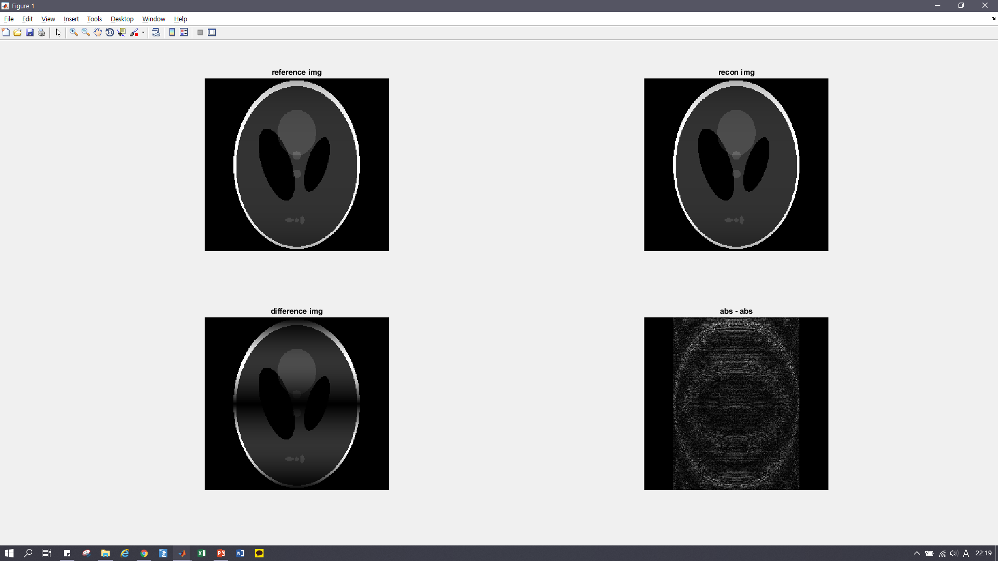
Ky = -2씩 shift
Y = 그대로

Slide 6
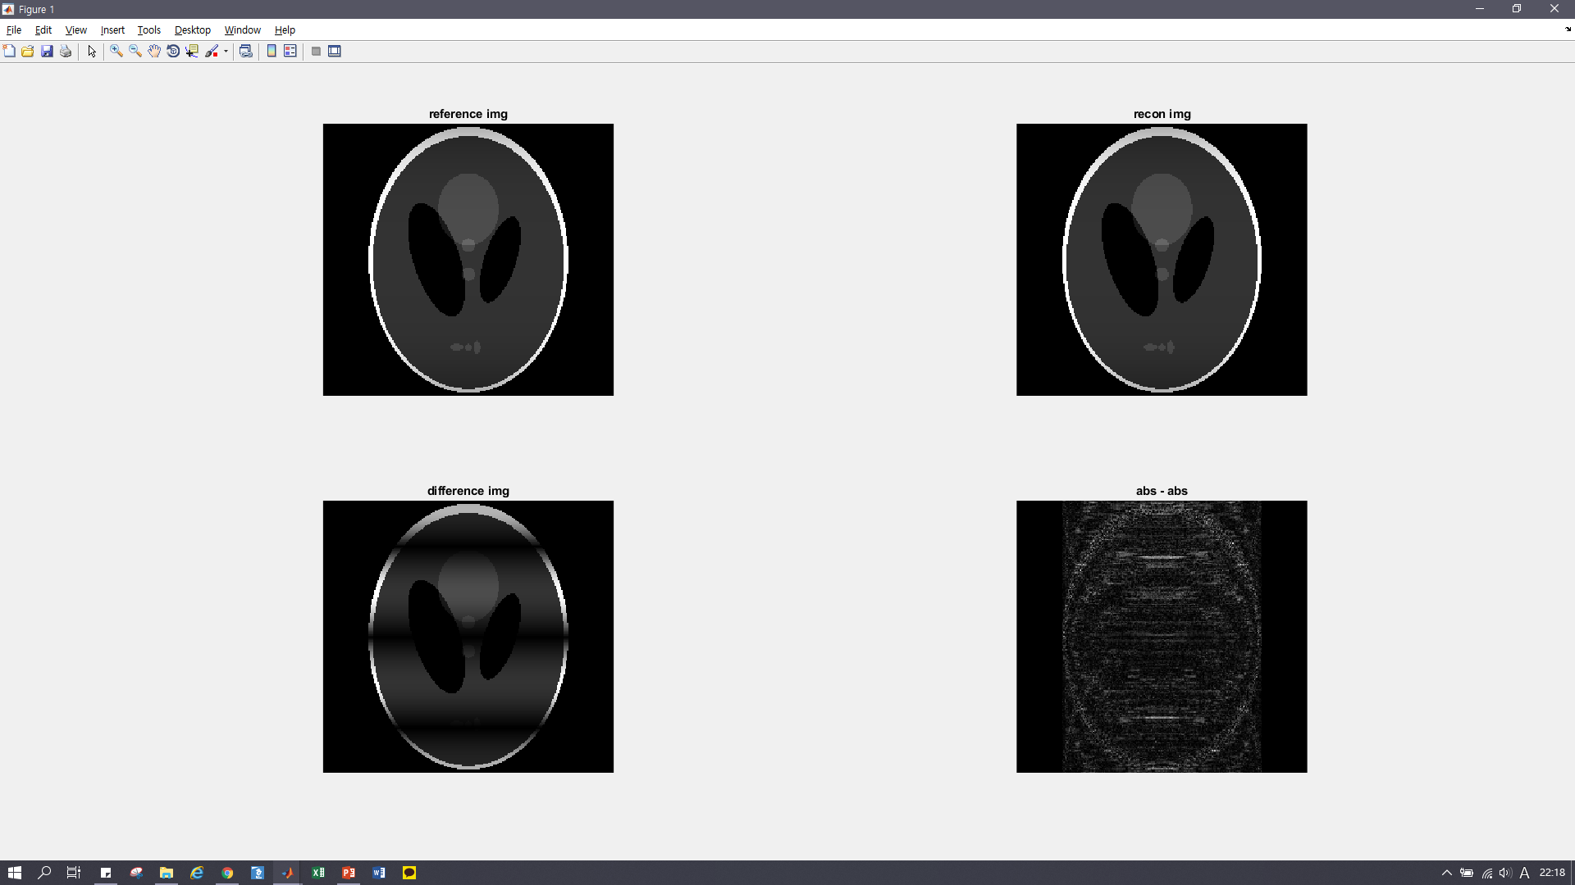
Ky = -3씩 shift
Y = 그대로

Slide 7
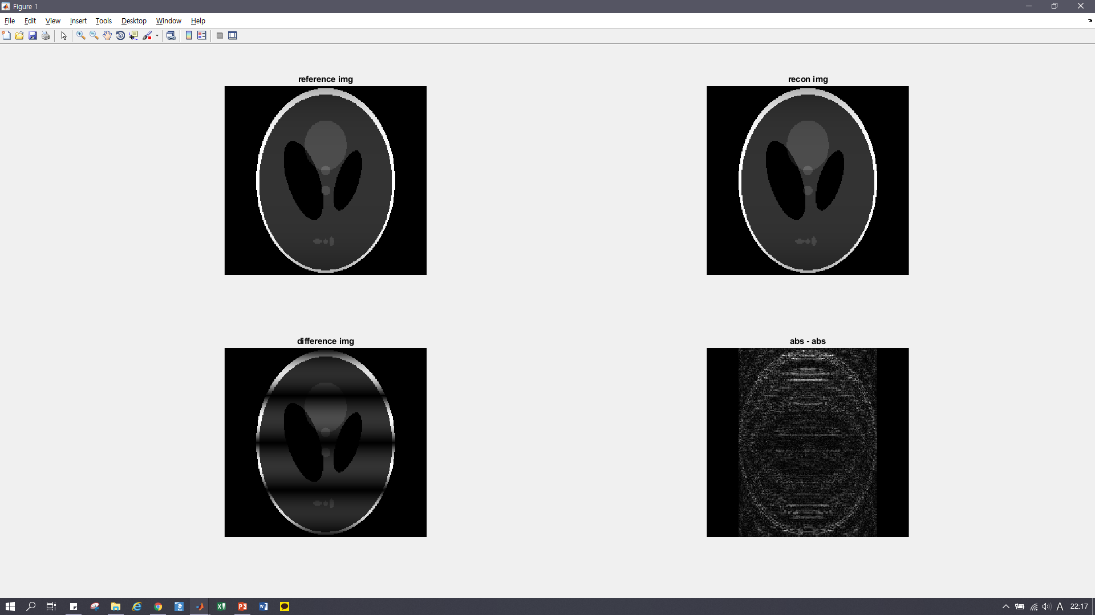
Ky = -4씩 shift
Y = 그대로

